Slide 1
Heart Disease Prediction System
Guide: Prof.Trupti thite
presented by-
Ankita m g [2JH21CS018]
kavya b k [2JH21CS048]
shravana t [2JH21CS091]
Vaishnavi a v [2JH21CS119]

Slide 2
CONTENTS:
Introduction
Objectives
Data Collection
Attributes Used
Libraries Used
Algorithms Used
Technology Used
System Design
Results
Conclusion

Slide 3
Introduction
Heart disease predictor is an offline platform designed and developed to explore the path of data science .The goal is to predict the health of a patient from collective data, so as to be able to detect configurations at risk for the patient, and therefore ,in cases requiring emergency medical assistance , alert the appropriate medical staff of the situation of the latter.
We initially have a data set collecting information of many patients with which we are able to conclude the results into a complete form and can predict data precisely.The results of the predictions ,derived from the predicted models generated by data science,will bw presented through several distinct graphical interfaces according to the data sets considered.We will then bring criticism as to the scope of our results.

Slide 4
Objectives
Develop an Accurate Prediction Model:
Utilize various machine learning algorithms to predict heart disease with high accuracy.
Compare Different Models:
Evaluate the performance of models such as Logistic Regression, Support Vector Machine, K-Nearest Neighbors, Decision Tree, Random Forest, and Gradient Boosting.
Data Preprocessing:
Perform data preprocessing including handling missing values, encoding categorical variables, and scaling features to prepare the dataset for model training.
Feature Selection:
Identify and use key attributes such as age, sex, chest pain type, resting blood pressure, serum cholesterol levels, fasting blood sugar, resting ECG results, maximum heart rate, exercise-induced angina, and other relevant features.

Slide 5
Model Evaluation:
Assess the models using metrics such as accuracy to determine the best performing model for heart disease prediction.
System Design and Implementation:
Implement the prediction models in a user-friendly offline platform that can alert medical staff in case of emergency situations based on predictive results.
Visualization of Results:
Present the prediction results through graphical interfaces for better understanding and analysis of the model performances.

Slide 6
Data collection
Data has been collected from Kaggle.
Data collection is the process of gathering and measuring information from countless different sources. In order to use the data we collect to develop practical artificial intelligence and machine learning solutions it must be collected and stored in a way that makes sense for the business problem at hand.
Kaggle is an online community of data scientists and machine learners, owned by Google LLC. Kaggle allow users to find and publish data sets,explore and build models in a web-based data-science environment,work with other data scientists and machine learning engineers,and enter competitions to solve data science challenges.

Slide 7
Attributes used
Age
Sex
Chest pain(Cp)
Serum cholesterol(Chol)
Fasting blood sugar(Fbs)
Resting ECG result(Rest ECG)
Maximum heart rate achieved(Thalach)
Exercise induced angina(Exang)
ST depression induced by exercise relative to rest(Oldpeak)
Slope of peak exercise ST segment(Slope)
Number of major vessels coloured by fluoroscopy(Ca)
Defect type(Thal)

Slide 8
Libraries Used
Pandas
Numpy
Seaborn
Matplotlib
Joblib
Scikit learn

Slide 9
Algorithms Used
Logistic Regression
SVM-Support Vector Machine
K-Nearest Neighbors
Decision Tree
Random Forest Classifier
Gradient Boosting Classifier

Slide 10
Testing Technologies
Anaconda (Python)- Anaconda is a free and open source distribution of the python and R programming languages for scientific computing , that aims to simplify package management and deployment.
Jupyter notebook- The jupyter notebook is an open source web application that allows you to create and share documents that contain live code, equations, visualizations and narrative text. Uses include : data cleaning and transformation, numerical simulation ,statistical modeling, data visualization, machine learning and much more.

Slide 11
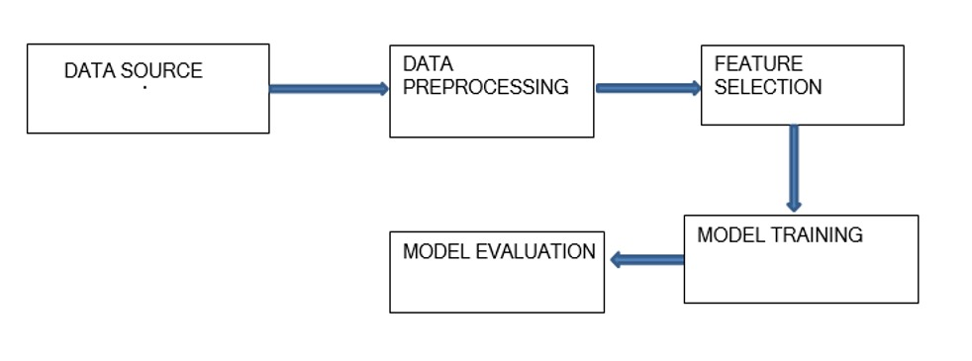
System design

Slide 12
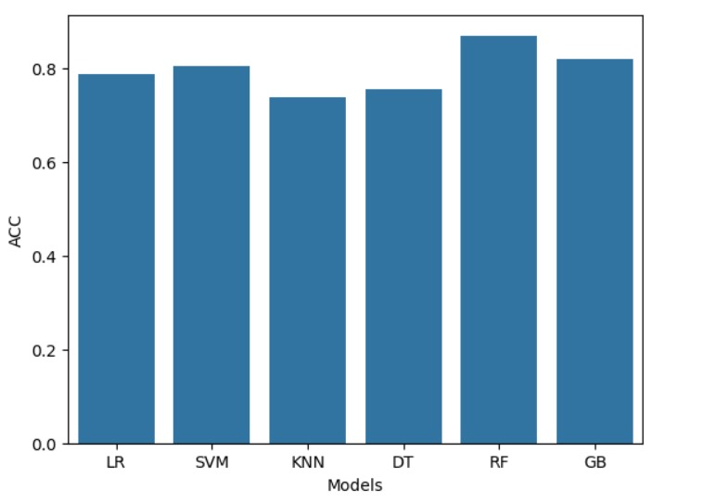
Models Accuracy
Models | Accuracy
Logistic Regression | 0.786885
Support Vector Machine | 0.803279
K-Nearest Neighbors | 0.737705
Decision Tree | 0.754098
Random Forest Classifier | 0.868852
Gradient Boost Classifier | 0.819672

Slide 13
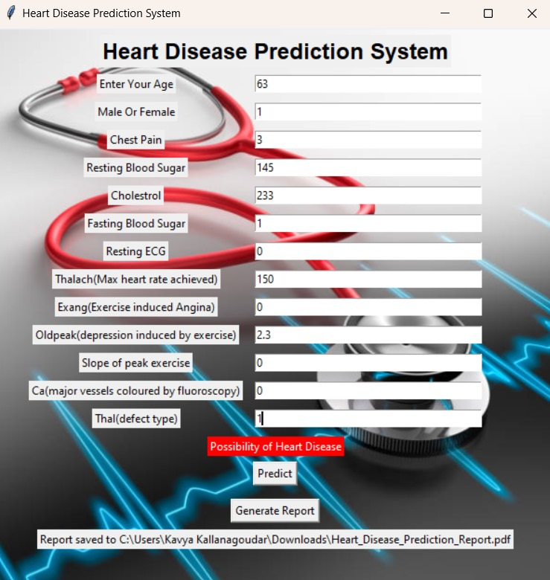
Predicted Result

Slide 14
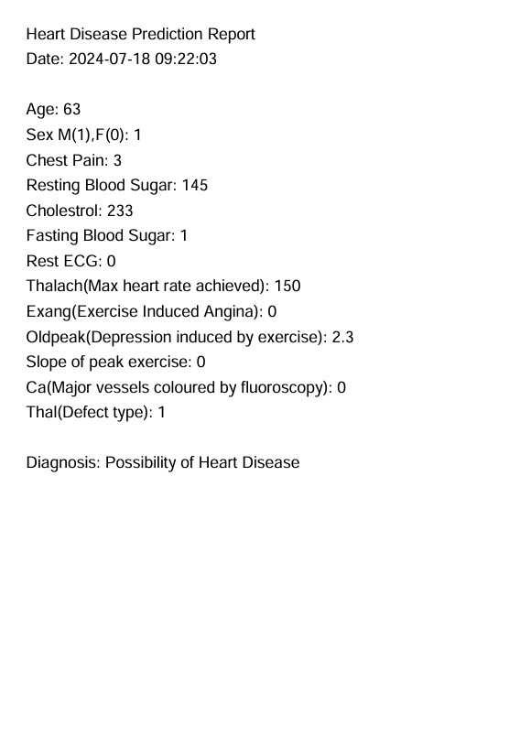
Generated Report

Slide 15
Conclusion
In this project, we developed and evaluated several machine learning models to predict heart disease using a dataset with various health indicators. We started with data preprocessing steps including handling missing and duplicate values, encoding categorical variables, and feature scaling. The processed data was then split into training and testing sets, and different models such as Logistic Regression, SVM, K-Nearest Neighbors, Decision Trees, and Random Forests were applied.
Our analysis showed that the Random Forest Classifier achieved the highest accuracy, demonstrating its effectiveness in predicting heart disease. The performance metrics indicated that this model could reliably differentiate between patients with and without heart disease. Despite some limitations, such as potential biases in the dataset and the need for further validation with diverse data, our model provides a promising tool for early detection of heart disease, which could aid in timely medical intervention and treatment planning.

Slide 16
Thank You

